Slide 1



Chapter - 5
Implementation of Deep Learning Algorithms

Slide 2

Unit
Deep Learning Techniques
1

Slide 3


DISCLAIMER
The content is curated from online/offline resources and used for educational purpose only.

Slide 4



Slide 5

Learning Objectives
Deep Learning:
Understand definition of deep learning
How deep learning is different from Machine learning
Understand fundamentals of deep neural network like neuron, activation functions, bias, weight, hyperparameters in neural network etc.
Convolutional Neural Network

Slide 6
What is Deep Learning?
Deep Learning is the subset of machine learning or can be said as a special kind of machine learning.
It works technically in the same way as machine learning does, but with different capabilities and approaches.
Deep learning models are capable enough to focus on the accurate features themselves by requiring a little guidance from the programmer.
Deep learning is implemented with the help of Neural Networks, and the idea behind the motivation of neural network is the biological neurons, which is nothing but a brain cell.
Notes:
Introduction:
Begin by defining deep learning as a specialized branch of machine learning.
Emphasize the similarities and differences between the two.
Key Points:
Functionality: Both deep learning and machine learning use algorithms to learn from data and make predictions.
Feature Extraction: Deep learning models excel at automatically identifying the most relevant features within data, reducing the need for extensive manual feature engineering.
Neural Networks: Deep learning relies heavily on neural networks, which are inspired by the structure and function of the human brain.
Biological Inspiration: Explain how the concept of neural networks was motivated by the biological neurons found in the brain.
Closing Remarks:
Summarize the key points about deep learning and its relationship to machine learning and neural networks.
Highlight the advantages of deep learning, such as its ability to handle complex tasks and learn from large amounts of data.

Slide 7
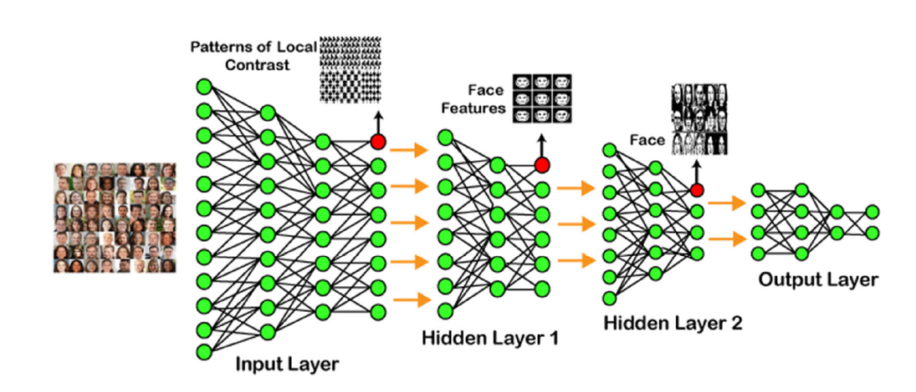
Example of Deep Learning?
Source :
https://www.javatpoint.com/deep-learning
Notes:
Example of Deep Learning: Facial Recognition
Image: A diagram illustrating a convolutional neural network (CNN) used for facial recognition.
Explanation:
This image depicts a CNN architecture, a common type of deep learning model, applied to the task of facial recognition.
Input Layer: The network receives an input image, such as a photograph of a person's face.
Convolutional Layers: These layers extract features from the image by applying filters that detect patterns like edges, corners, and curves.
Pooling Layers: These layers downsample the feature maps, reducing computational complexity while preserving essential information.
Fully Connected Layers: These layers combine the extracted features to produce a final output, which in this case is a prediction of the person's identity.
Output Layer: The final layer outputs a probability distribution over possible identities, indicating the likelihood of each person being the correct match.
Key Points:
Feature Learning: CNNs automatically learn relevant features from the data, making them effective for tasks like image recognition.
Hierarchical Representation: The network learns from simple features (e.g., edges) to more complex ones (e.g., facial parts).
Deep Architecture: The multiple layers allow CNNs to capture intricate patterns and relationships within the data.
Applications:
Security: Access control, biometric authentication
Surveillance: Identifying individuals in crowds
Social Media: Tagging friends in photos
Law Enforcement: Identifying suspects

Slide 8
Machine Learning Vs Deep Learning
Machine Learning and Deep Learning are the two main concepts of Data Science and the subsets of Artificial Intelligence.
Most of the people think the machine learning, deep learning, and as well as artificial intelligence as the same buzzwords. But in actuality, all these terms are different but related to each other.
Source :
https://www.edureka.co/blog/ai-vs-machine-learning-vs-deep-learning/
Notes:
Introduction:
Begin by defining machine learning and deep learning as subsets of artificial intelligence.
Clarify that while often used interchangeably, they represent distinct concepts.
Key Differences:
Feature Engineering:
Machine learning typically requires manual feature engineering to extract relevant information from data.
Deep learning automatically learns features through neural networks.
Complexity:
Machine learning often involves simpler algorithms and models.
Deep learning uses complex neural networks with multiple layers.
Data Requirements:
Machine learning generally requires less data than deep learning.
Deep learning needs large amounts of data to train effectively.
Applications:
Machine learning is suitable for a variety of tasks like regression, classification, and clustering.
Deep learning excels in complex tasks like image recognition, natural language processing, and speech recognition.
Visual Aid:
Use a Venn diagram to illustrate the relationship between AI, ML, and DL.
Conclusion:
Summarize the key differences between machine learning and deep learning.
Emphasize that while both are valuable tools, their choice depends on the specific task and available data.

Slide 9
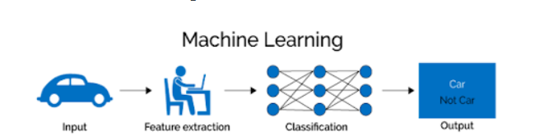
How Machine Learning Works?
The working of machine learning models can be understood by the example of identifying the image of a car or Not car.
To identify this, the ML model takes images of car as input, extracts the different features of images such as shape, height, etc., applies the classification algorithm, and predict the output.
Source :
https://builtin.com/machine-learning/deep-learning
Notes:
Introduction:
Begin by explaining that machine learning models learn from data to make predictions or decisions.
Use the example of cat and dog classification to illustrate the process.
Key Points:
Input: The model receives images of cats and dogs as input data.
Feature Extraction:
The model extracts relevant features from the images, such as shape, size, color, and texture.
These features are numerical representations that the model can process.
Classification:
The extracted features are fed into a classification algorithm.
The algorithm analyzes the features and assigns the image to one of two categories: "cat" or "dog."
Output:
The model produces a prediction, indicating whether the input image is a cat or a dog.
Visual Aid:
Use the provided image to demonstrate the steps involved in the machine learning process.
Closing Remarks:
Summarize the key points about how machine learning works.
Emphasize that the model learns from data and improves its accuracy over time.

Slide 10
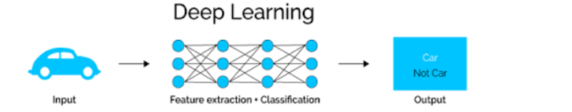
How Deep Learning Works?
We can understand the working of deep learning with the same example of identifying Car vs. Not car.
The deep learning model takes the images as the input and feed it directly to the algorithms without requiring any manual feature extraction step.
The images pass to the different layers of the artificial neural network and predict the final output.
Source :
https://builtin.com/machine-learning/deep-learning
Notes:
Introduction:
Begin by explaining that deep learning models are a subset of machine learning that use neural networks.
Use the example of cat vs. dog classification to illustrate the process.
Key Points:
Input: The model receives images as input data.
Feature Extraction:
Unlike traditional machine learning, deep learning models automatically learn relevant features from the data.
The neural network extracts features through multiple layers.
Classification:
The extracted features are processed by the neural network to make a classification.
The final layer of the network produces an output, indicating whether the image is a cat or a dog.
Output:
The model produces a prediction, indicating the most likely category for the input image.
Visual Aid:
Use the provided image to demonstrate the steps involved in the deep learning process.
Closing Remarks:
Summarize the key points about how deep learning works.
Emphasize the automatic feature extraction capability and the use of neural networks.

Slide 11
Which one to Select – ML or DL?
Source :
https://www.javatpoint.com/machine-learning-vs-deep-learning
Notes:
Introduction:
Begin by emphasizing that the choice between machine learning (ML) and deep learning (DL) depends on several factors.
Highlight the importance of understanding the specific requirements of your project.
Key Considerations:
Data Availability:
ML: Can work with smaller datasets.
DL: Requires large amounts of data to train effectively.
Complexity of the Task:
ML: Suitable for simpler tasks and structured data.
DL: Excel at complex tasks and unstructured data (e.g., images, text).
Resources:
ML: Generally requires less computational power and expertise.
DL: Demands powerful hardware and specialized knowledge.
Conclusion:
Summarize the key factors to consider when choosing between ML and DL.
Emphasize that the best approach may vary depending on the specific project and its goals.

Slide 12
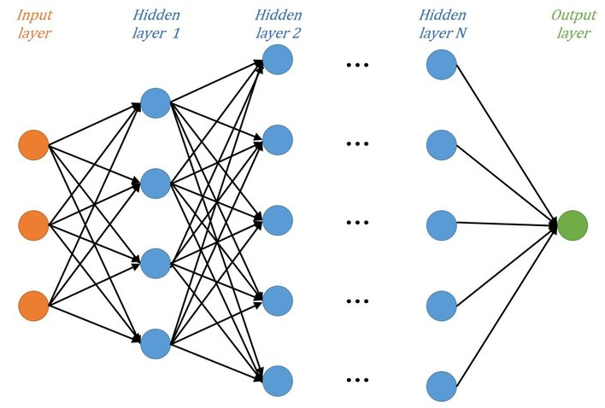
Deep Neural Networks(DNN)​
A hierarchical organization of neurons with connections to other neurons is a simplified representation of a DNN.​
Deep Neural Networks gained their name from the fact that they utilized a lot of hidden layers to learn more intricate patterns, giving them the label "deep".
Based on the received input, these neurons send a message or signal to other neurons, forming a complex network that learns through a feedback loop.
Reference link

Slide 13
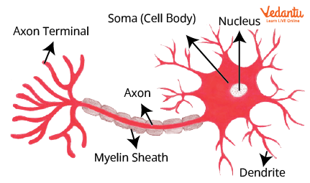
Neurons
Neurons in deep learning models are nodes through which data and computations flow.
Neurons receive one or more input signals.
These input signals can come from either the raw data set or from neurons positioned at a previous layer of the neural net.
Reference link

Slide 14
Weights and Bias
Weights enable the artificial neural network to dial up or dial down connections between neurons.
Bias can be used to make adjustments within neurons.
Bias can be positive or negative, increasing or decreasing a neuron’s output
Input 1
Input 2
Weight 1
Weight 2
Bias
Output
Reference link

Slide 15
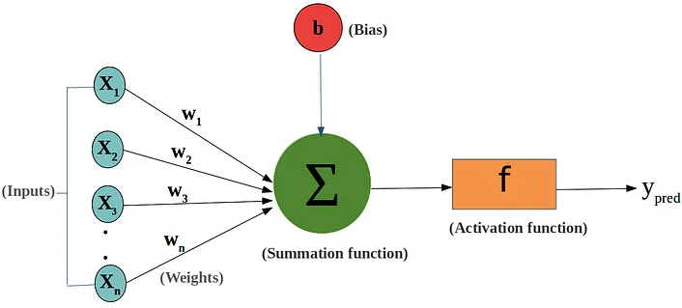
Components of Artificial Neuron
Reference link

Slide 16
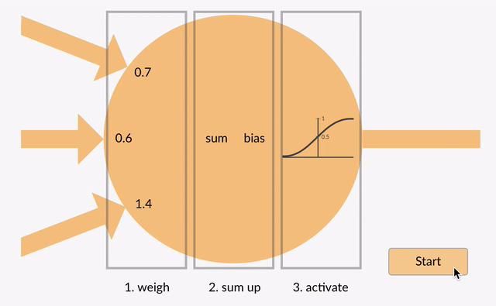
Single Neuron
Reference link

Slide 17
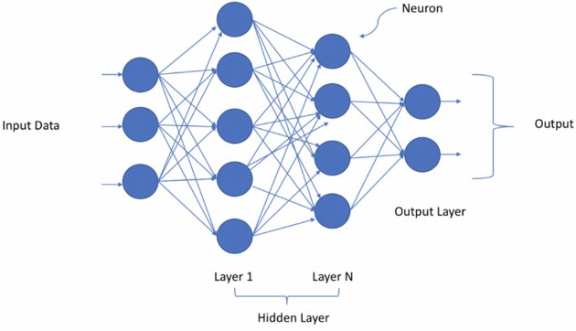
Representation of DNN ​

Slide 18
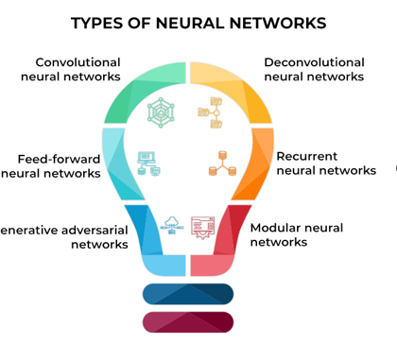
Types of Deep Neural Networks
Four Types of Neural Network Architecture:
Feedforward Neural Networks (FNNs)
Convolutional Neural Networks (CNNs)
Recurrent Neural Networks (RNNs)
Generative Adversarial Networks (GANs)
Source
https://www.coursera.org/articles/neural-network-architecture
Notes:
In this slide, the trainer will discuss the four main types of Neural Network architectures:
Feedforward Neural Networks (FNNs): Basic neural network architecture with one-way data flow.
Convolutional Neural Networks (CNNs): Designed for image processing and recognition tasks.
Recurrent Neural Networks (RNNs): Suitable for sequential data and time series analysis.
Generative Adversarial Networks (GANs): Consist of two networks (generator and discriminator) that compete to improve data generation quality.

Slide 19
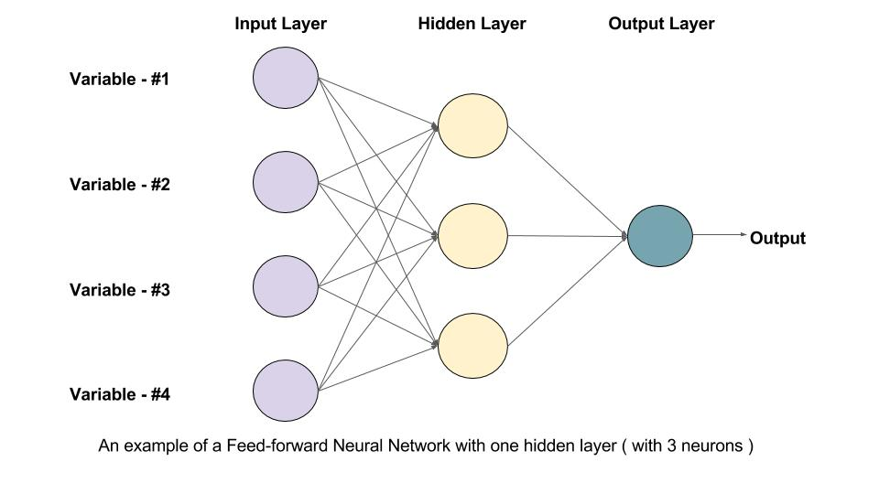
Feedforward Neural Networks
Feedforward Neural Networks
Basic form of neural networks
Data flows forward from input to output
No loops or cycles
Used for:
Pattern and image recognition
Regression analysis
Classification
How FNNs Work
Consist of input layer, hidden layers, and output layer
Data passes through nodes in each layer
Each node connects to every node in the next layer
Figure 2.5
Source
https://www.coursera.org/articles/neural-network-architecture
Notes:
In this slide, the trainer will explain Feedforward Neural Networks (FNNs):
Feedforward Neural Networks:
Basic neural network type.
Data flows one way, from input to output.
No loops or cycles.
Applications: pattern/image recognition, regression analysis, classification.
How FNNs Work:
Composed of input layer, hidden layers, and output layer.
Data passes through nodes in each layer.
Each node connects to every node in the next layer.

Slide 20
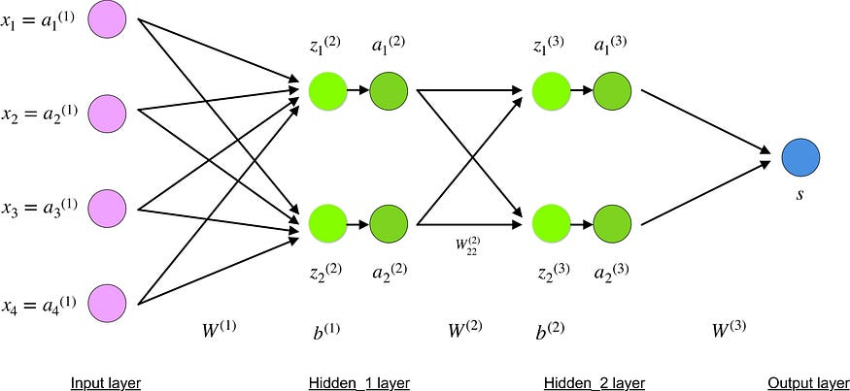
Backpropagation Algorithm
Backpropagation is an efficient algorithm for calculating gradients (derivatives of the error function) with respect to weights and biases in a multi-layered neural network.
It works by propagating the error backward through the network, layer by layer.
At each layer, the error is used to calculate the gradients for the weights and biases connecting that layer to the previous layer.
Figure 5.43
Source
https://towardsdatascience.com/understanding-backpropagation-algorithm-7bb3aa2f95fd
Notes:
Backpropagation is the workhorse for gradient calculation in multi-layered neural networks. It operates by systematically propagating the error backward through the network, layer by layer. At each layer, the error is used to compute the gradients for the weights and biases connecting that layer to the previous layer. These gradients essentially tell us how much each weight or bias in the network contributed to the overall error.

Slide 21
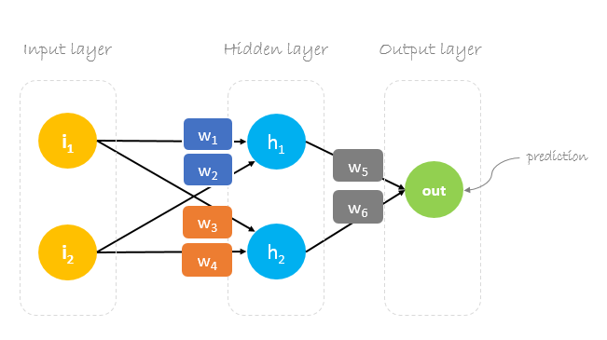
Steps in Backpropagation
Forward Pass:
The input data is propagated forward through the network, calculating activations at each layer.
Error Calculation:
The error (difference between predicted and actual output) is computed at the output layer.
Backward Pass:
The error is propagated backward through the network, layer by layer.At each layer, gradients for weights and biases are calculated using the chain rule.
Weight Update:
The weights and biases are updated using an optimization algorithm (e.g., gradient descent) based on the calculated gradients.
Figure 5.44
Source
https://paperswithcode.com/method/leaky-relu
Notes:
Backpropagation involves a forward pass and a backward pass. In the forward pass, the input data travels through the network, layer by layer, calculating the activation values at each neuron. Once the output is generated, the error is computed by comparing the predicted output with the actual target value. Then comes the crucial backward pass. The error is propagated backward, layer by layer. At each layer, the chain rule, a mathematical technique for differentiating composite functions, is employed to calculate the gradients for the weights and biases connecting that layer to the previous one. Finally, these gradients are used to update the weights and biases in a direction that minimizes the overall error. This iterative process of forward pass, error calculation, backward pass, and weight update continues until the network converges or reaches a satisfactory level of performance

Slide 22
Gradient Descent​
Gradient Descent is known as one of the most used optimization algorithms to train machine learning models by means of minimizing errors between actual and expected results.​
Gradient descent was initially discovered by "Augustin-Louis Cauchy" in the mid 18th century.​
Gradient Descent is defined as one of the most used iterative optimization algorithms of machine learning to train the machine learning and deep learning models. It helps in finding the local minimum of a function.​
​
The best way to define the local minimum or local maximum of a function using gradient descent is as follows:​
If we move towards a negative gradient or away from the gradient of the function at the current point, it will give the local minimum of that function.​
Whenever we move towards a positive gradient or towards the gradient of the function at the current point, we will get the local maximum of that function.
Notes:
Now understand what is Gradient Descent​ ​
Gradient Descent is a popular optimisation approach for training machine learning models by minimising errors between actual and expected results.​
"Augustin-Louis Cauchy" discovered gradient descent in the mid-18th century.​
Gradient Descent is a machine learning iterative optimisation approach that is commonly used to train machine learning and deep learning models. It aids in determining a function's local minimum.​
Gradient Descent is an iterative optimisation procedure that is used to minimise a machine learning model's loss function by altering its parameters such as weights and biases. It is a fundamental technique used to train numerous types of machine learning models, such as neural networks. Gradient Descent seeks the ideal set of parameters that yields the lowest possible value of the loss function, showing the best fit of the model to the training data.​
​
The following is the easiest technique to define a function's local minimum or local maximum using gradient descent:​
Moving towards a negative gradient or away from the gradient of the function at the current location will yield the function's local minimum.​
We shall get the local maximum on that function whenever we move towards a positive gradient or the gradient of the function at the present position.​
​
If the gradient at a point is near 0 and positive, you are on the left side of a local minimum. As you advance to the right, the function becomes more powerful. If the gradient at a place is near to 0 and negative, you're on the correct side of a local minimum. As you advance to the left, the function becomes more powerful.​
If the gradient at a place is near to 0 and positive, you are on the correct side of a local maximum. As you move to the right, the function becomes smaller. If the gradient at a place is near 0 and negative, you are on the left side of a local maximum. As you proceed to the left, the function becomes smaller.​
​
​
​

Slide 23
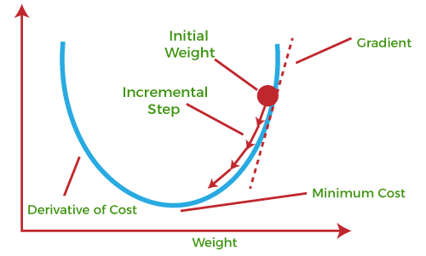
Gradient Descent​
Notes:
If we have the derivative, we can simply increase/decrease the weights and biases with it (refer to the earlier diagram). This is referred to as gradient decline.​
​
The graphic above shows the loss for various weight combinations between nodes. As the graphic shows, if we are unlucky, we can become caught in local minima, i.e. areas where the gradient is zero, but this is not the global minimum, i.e. the weight combination with the lowest potential loss. This is simply a fact of life for neural networks; you are not guaranteed to get the best solution. various weight initializations will result in various minima, which can differ significantly.​
In either case, we minimise the loss by calculating the gradient of the loss function in our present state and adjusting our weights accordingly. The gradient's sign (+ or -) indicates which way to proceed, and the magnitude indicates how large the steps should be. In essence, we begin at some random point on the graph above and work our way down until we reach the green dot.

Slide 24
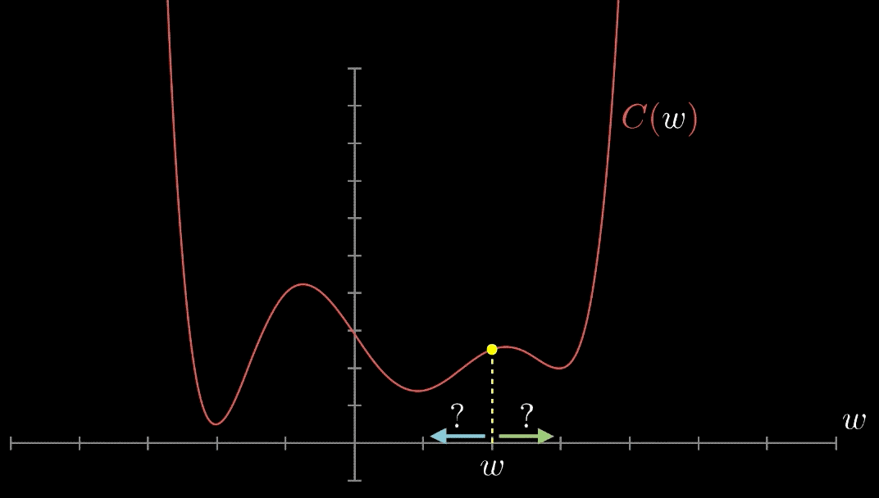
Gradient Descent
Notes:
So , Gradient descent is an optimization process that minimizes a differentiable function by iteratively subtracting its partial derivatives from its weights, moving them to the bottom of it.​
​
In the graph, a quadratic function is shown in relation to any single weights or biases. Keeping in mind what we discussed earlier, and that gradient descent is the optimisation process that seeks the bottom of the function (the location with the lowest loss), the gradient can be viewed as the rate of change of the loss, or the slope. So, gradient descent is the method for changing the loss function, for decreasing it, by tweaking the weights and biases that were initially chosen at random. Because the following stages will no longer be random, but will instead be changed based on the value of the loss function.​
Gradient descent can be thought of as a method of teaching the model to forecast better.​
As a result, if the gradient (and thus the slope) is positive, raising the weight value reduces the loss. Conversely, if the gradient is negative (and so a negative slope), by decreasing the weight’s value the loss will decrease.​
​

Slide 25
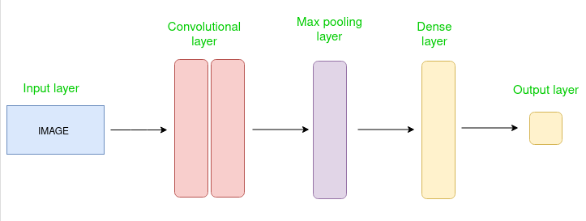
Convolutional Neural Networks
Specialized in recognizing patterns and images
Used for:
Computer Vision
Handwritten zip code recognition
How CNNs Work
Contain input, convolutional, pooling, and output layers
Convolutional layers filter input to extract features
Pooling layers simplify parameters while retaining key information
Figure 2.7
Source
https://www.coursera.org/articles/neural-network-architecture
Notes:
In this slide, the trainer highlights the specialized capabilities of Convolutional Neural Networks (CNNs) in recognizing patterns and images. CNNs are extensively employed in various applications, notably in Computer Vision tasks such as image classification, object detection, and segmentation. One of their notable applications is in handwritten zip code recognition, where CNNs excel in accurately deciphering handwritten digits.
The trainer introduces how CNNs function, comprising input, convolutional, pooling, and output layers. Convolutional layers play a crucial role in filtering input data to extract essential features, enabling the network to recognize patterns effectively. Meanwhile, pooling layers help simplify parameters while retaining critical information, contributing to the network's efficiency in processing large datasets.

Slide 26
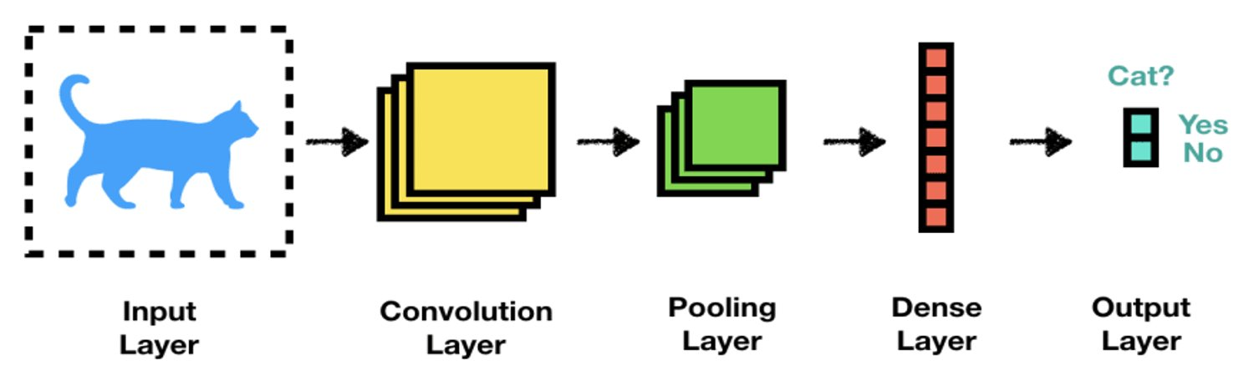
Convolutional Neural Network​
CNNs have stacked layered architecture of several Convolution and Pooling Layers​
Notes:
Now let’s have look on CNN Convolutional Neural Network​
​
Let’s start with what Is the CNN and later we will see the image​
​
A convolutional neural network is a feed-forward neural network that is generally used to analyze visual images by processing data with grid-like topology. It’s also known as a ConvNet. A convolutional neural network is used to detect and classify objects in an image​
​
The following figure illustrates a CNN with one convolution layer, one pooling layer, and one dense layer. The task is to predict whether the image depicts a cat. Layers that are in-between the input and output layer are also referred to as hidden layers as there state is not directly visible when treating the model as a black box.​
​

Slide 27
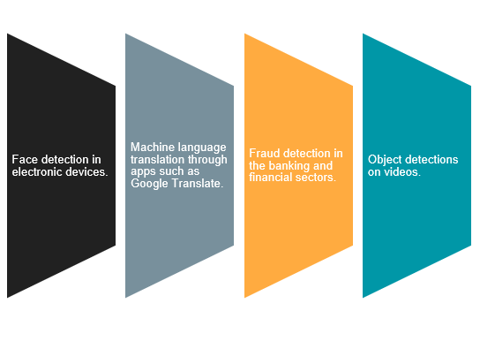
TensorFlow 2.0 & Keras API
Tensor
TensorFlow 2.0 is a library that provides a comprehensive ecosystem of tools for developers, researchers, and organizations who want to build scalable Machine Learning and Deep Learning applications.
TensorFlow Applications
Syntax:
import tensorflow as tf

Slide 28
Building a model in Keras
1
Define Network
2
Compile Network
3
Fit Network
4
Evaluate Network
5
Make Predictions

Slide 29

What is Keras?
Keras is a deep learning API written in Python, running on top of the machine learning platform TensorFlow.
It was developed with a focus on enabling fast experimentation. Being able to go from idea to result as fast as possible is key to doing good research.
Reference link

Slide 30
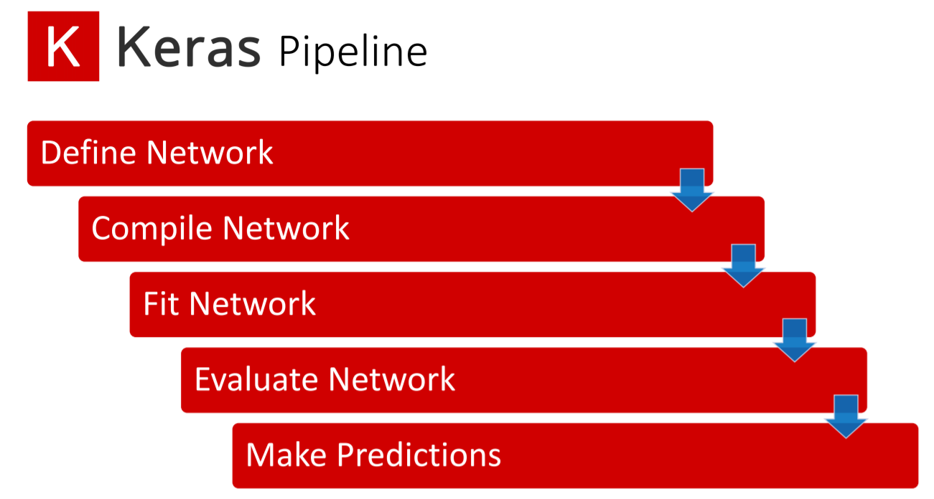

Slide 31

Lab Activity
Hands On
Lab 1
First Neural Network with Keras

Slide 32
Conclusion
So we have learned what is Deep Learning , and how it is related to AI and how it is different from AI and ML.
Bias, weight, activation function are core components of a neuron.
In Feedforward neural network the information moves in only one direction —forward—from the input nodes, through the hidden nodes (if any), and to the output nodes.
Convolutional Neural Network

Slide 33
References
https://setosa.io/ev/image-kernels/
https://towardsdatascience.com/understand-transposed-convolutions-and-build-your-own-transposed-convolution-layer-from-scratch-4f5d97b2967
https://www.simplilearn.com/tutorials/deep-learning-tutorial/deep-learning-algorithm
https://medium.com/voice-tech-podcast/text-classification-using-cnn-9ade8155dfb9

Slide 34


Slide 35

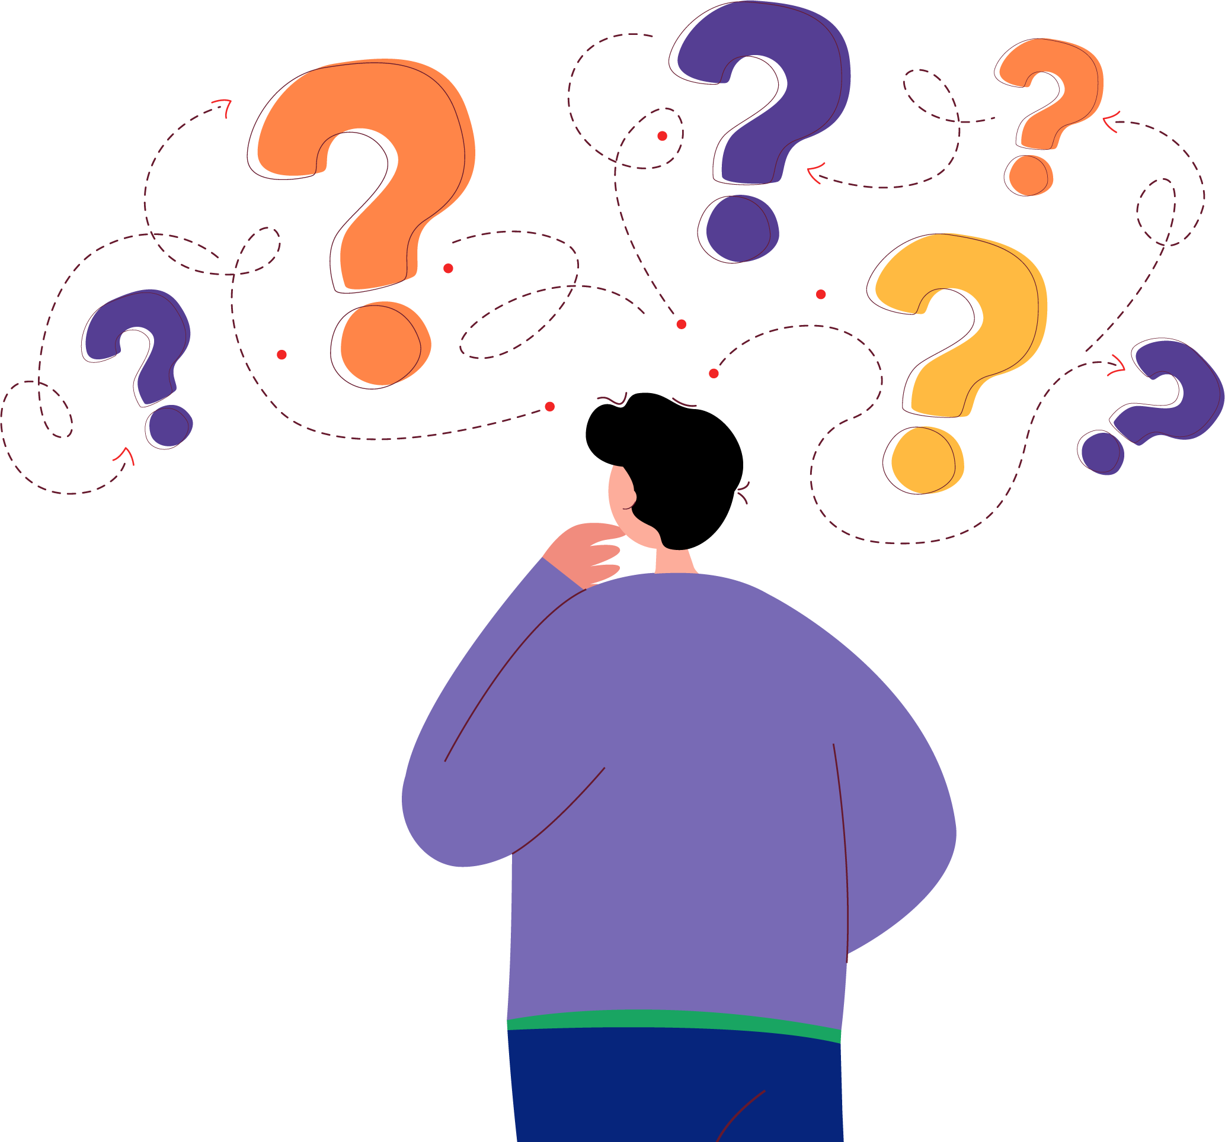
Quiz
1. In deep learning, what is backpropagation used for?​
A) Initializing neural network weights ​
B) Calculating the loss function ​
C) Updating neural network weights ​
D) Determining the number of hidden layers
Answer: C

Slide 36
Quiz
2. What is the primary objective of deep learning?​
​
A) Feature engineering ​
B) Data visualization ​
C) Automatic feature learning ​
D) Data preprocessing
Answer: C

Slide 37
Quiz
3. ____________in which we give input to our model.
Input layer
Output layer
Hidden layer
None
Answer: A

Slide 38
Quiz
4. Which type of neural network is commonly used for image classification tasks?
a) Recurrent Neural Networks (RNNs) b) Convolutional Neural Networks (CNNs) c) Generative Adversarial Networks (GANs) d) Long Short-Term Memory (LSTM) networks
Answer: B

Slide 39
Thank You
Notes:
Thank You !!

